Slide 1
Interactive Kanban Board
Group 1
Notes:
André
Ok so hi.

Slide 2
Recap
Notes:
André
We’re gonna start off with a quick recap of who we are and what project we’re doing.

Slide 3
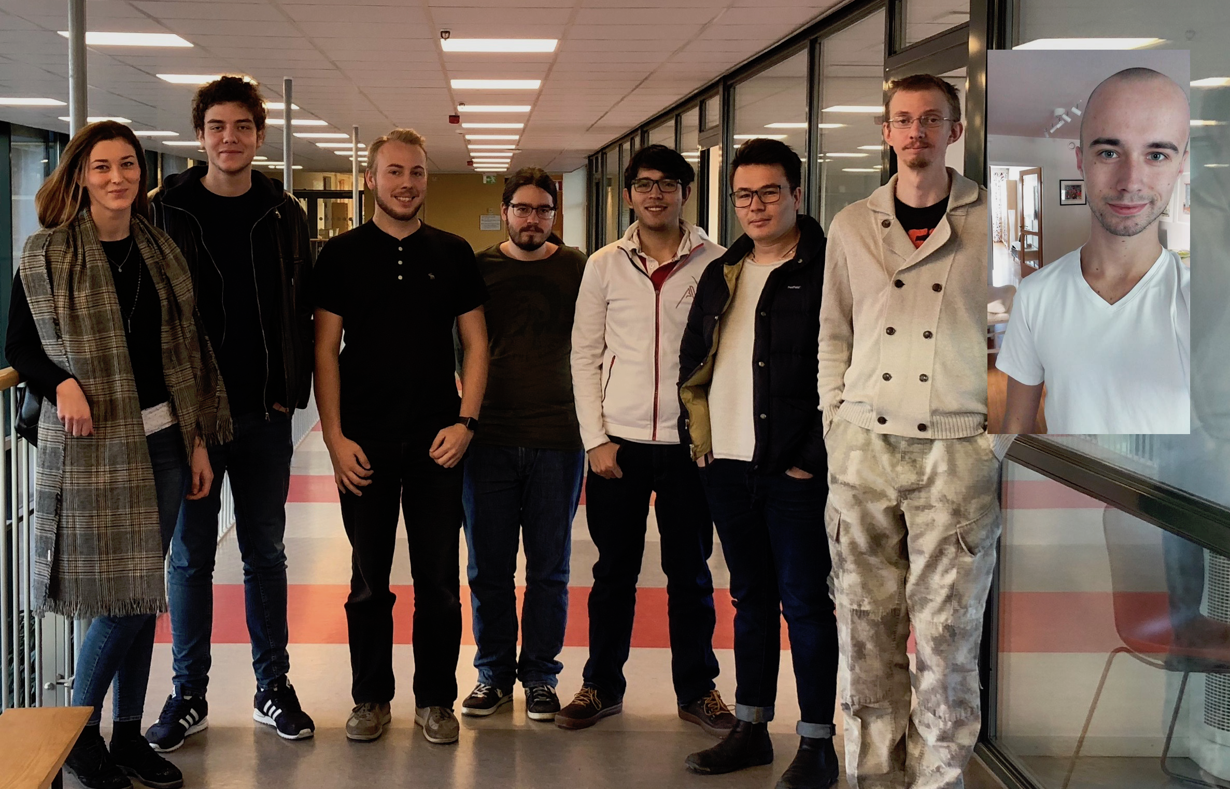
Who are we?
Notes:
André
We’re group one. My name is André, this is ...

Slide 4
Our Client
ABB Ports
Christoffer Holmstedt
TeamForge by CollabNet
Notes:
André
ABB Ports.
Contact person is Christoffer Holmstedt, team lead.
They use Teamforge by CollabNet for keeping track of their issues.
Teamforge has a lot of functionality
They need a more customizable kanban board.
Yeah so our client is ABB Ports.
And our contact person there is Christoffer Holmstedt, who is working as a team lead.
Right now, they are using a software called TeamForge by CollabNet. They basically use teamforge as a way of keeping track of everything that need to be done. Kinda like keeping track of all of their issues.
Now, teamforge already has a lot of functionality and features built in. They already have a kanban board.
But the thing is, it’s not really good enough for our client. They want a kanban board that’s a bit more customizable.
They do wanna keep using teamforge for tracking all of their issues.
But they need a new kanban board.

Slide 5
The Product
Kanban Board
Web Application
Connected with TeamForge
Admin / User
Authentication mainly through TeamForge
“Always” available
Notes:
André
Kanban board
Web application
connected with TeamForge
Two user roles admin and normal user
Doing authentication mainly through teamforge
Application should be available even when teamforge is down.
So that’s where we come in. We’re gonna create a kanban board.
It will be a web application that’s connected to teamforge.
So they will still enter all of their issues into teamforge, and then import those into our application.
There will be two different user roles. Admins that does the importing and can customize the board, while normal users can move issues around on the board.
Now we’ll do authentication mainly thru teamforge. But they also have this requirement that even if teamforge is down, our application should be available.
So as a backup we’ll have local users as well.

Slide 6
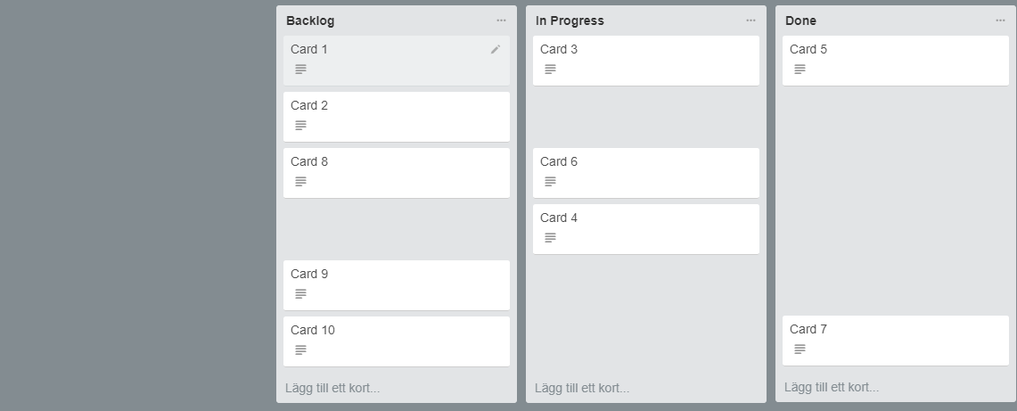
Swimlane A
Swimlane B
Swimlane C
Taken from www.trello.com & photoshopped
Notes:
André
Basically how our board will look.
Taken from trello and photoshopped.
Issue in teamforge is called an artifact, has title, description and a project assigned to it.
Categories
Parent categories
Swimlanes
Admin customization of categories, parent categories and swimlanes
Now this is almost how the board will look when we’re done. This is not our board, it was taken from a site called trello and photoshopped a bit.
So in teamforge, every issue that they create is called an artifact. So an artifact has things like a title and a project assigned to it, along with some other stuff.
An artifact is then represented on the board as a card when they choose to add it.
We have categories, which are the column. Here we have Backlog, In Progress and Done.
You will also be able to have something called a parent category. It’s not in the image, but it’s like a category that contains and groups together other categories.
We also have swimlanes, which is a horizontal grouping, so here we have A, B and C.
Admins will be able to add, delete and move around both the categories and swimlanes.

Slide 7
Changes since last time
How artifacts are selected and imported
Authentication for Admins
Notes:
André
How artifacts are imported
Authentication for admins
Since the last presentation, we’ve had a meeting with our client
And we learned that a couple of new things.
We had a meeting with our contact person Christoffer. And we learned that, when an admin imports new artifacts into our application, they wanna to be able to select them by what project they belong to.
We also learned that not everyone who is supposed to be an admin in our application, is one in teamforge. This means that we can’t rely entirely on the teamforge user roles. We’ll talk a bit more about that later.

Slide 8
Implementation so far

Slide 9


Environment Setup (Laravel, MySQL)
TeamForge Server Setup
Styling
Research about reusable functionalities
Notes:
Environment Setup (Laravel, MySQL)
TeamForge Server Setup
Styling
Research about reusable functionalities

Slide 10
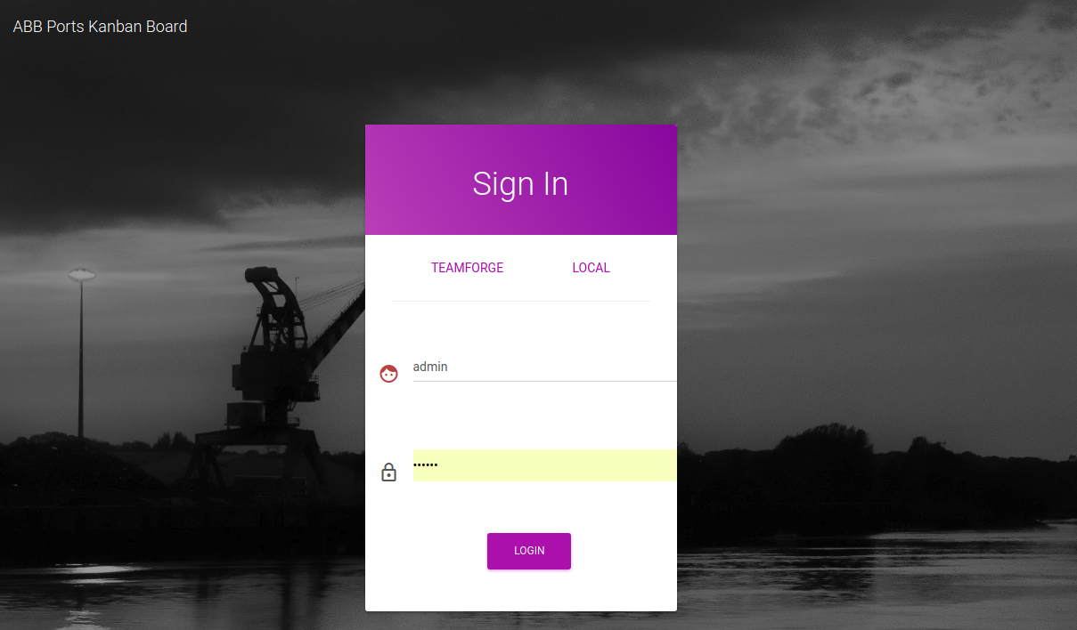
Login page for local users

Slide 11
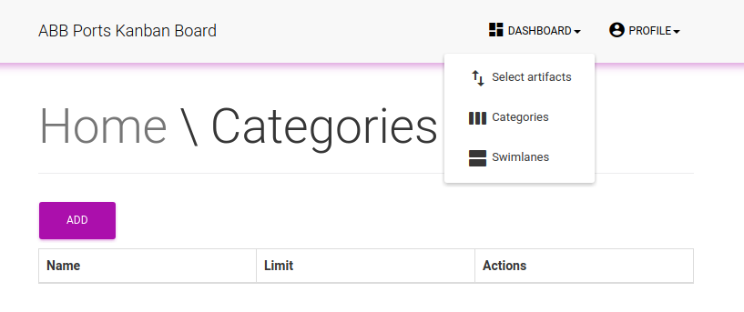
Administrator
Add/remove/edit categories

Slide 12
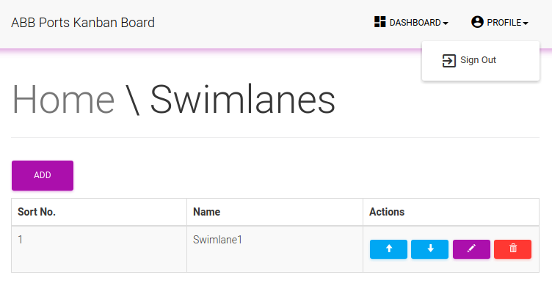
Administrator
Add/remove/edit swimlanes

Slide 13
Upcoming Implementation

Slide 14
Create backend functionality for pulling artifacts from Teamforge
Add TeamForge login
Create kanban card with its drag and drop functionality
Create necessary migrations of artifacts, projects
Validation and error handling
Style
Testing
Notes:
Create backend functionality for pulling artifacts from Teamforge
Add TeamForge login
Create kanban card with its drag and drop functionality
Create necessary migrations of artifacts, projects
Validation and error handling
Style
Testing

Slide 15
Main design decisions

Slide 16
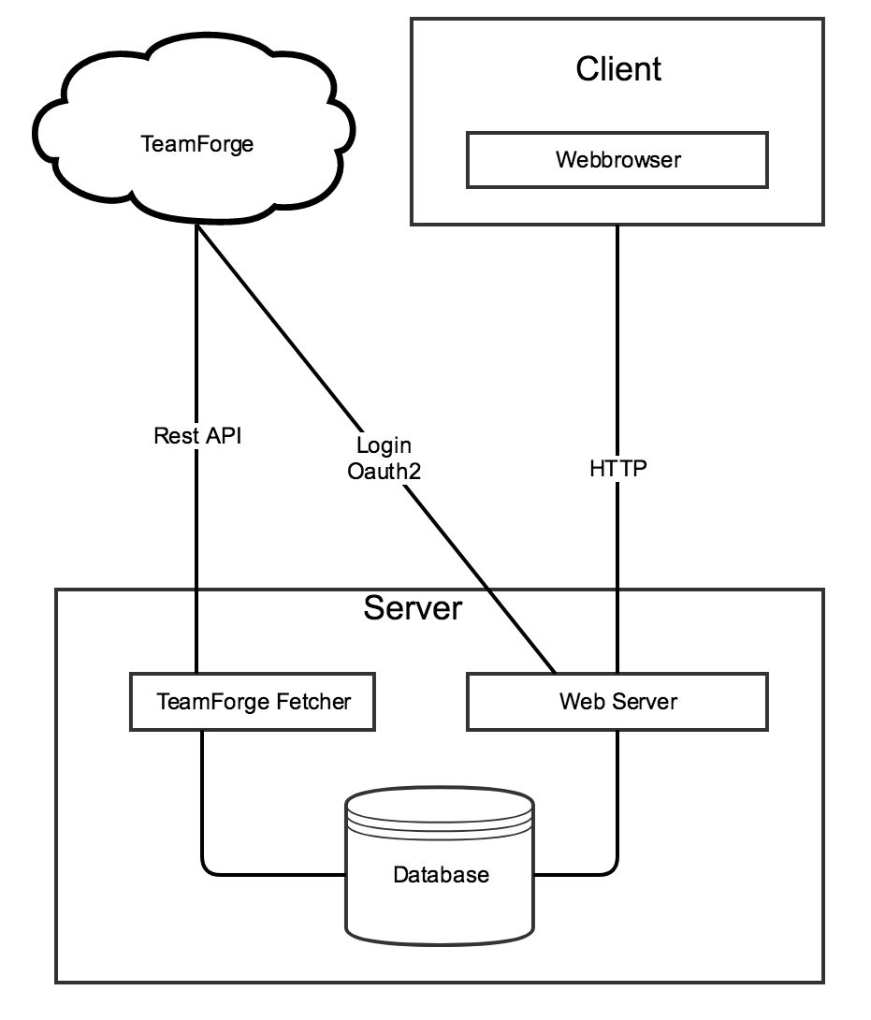
System overview
Web based application - mobile responsive
Laravel framework - MVC Architecture
MySQL server for persistent data
TeamForge’s REST API - Oauth2 for authentication

Slide 17
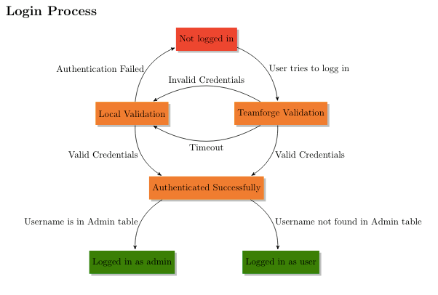

Slide 18
Additional important points of system design
Application security - fetching artefacts
Synchronization and timing

Slide 19
Detailed software design

Slide 20
MVC
Divides application into three parts:
Model
View
Controller

Slide 21
Model-View-Controller
Models:
Card
Swimlane
Category
User
Views:
Login
Managing Swimlanes
Managing Categories

Slide 22
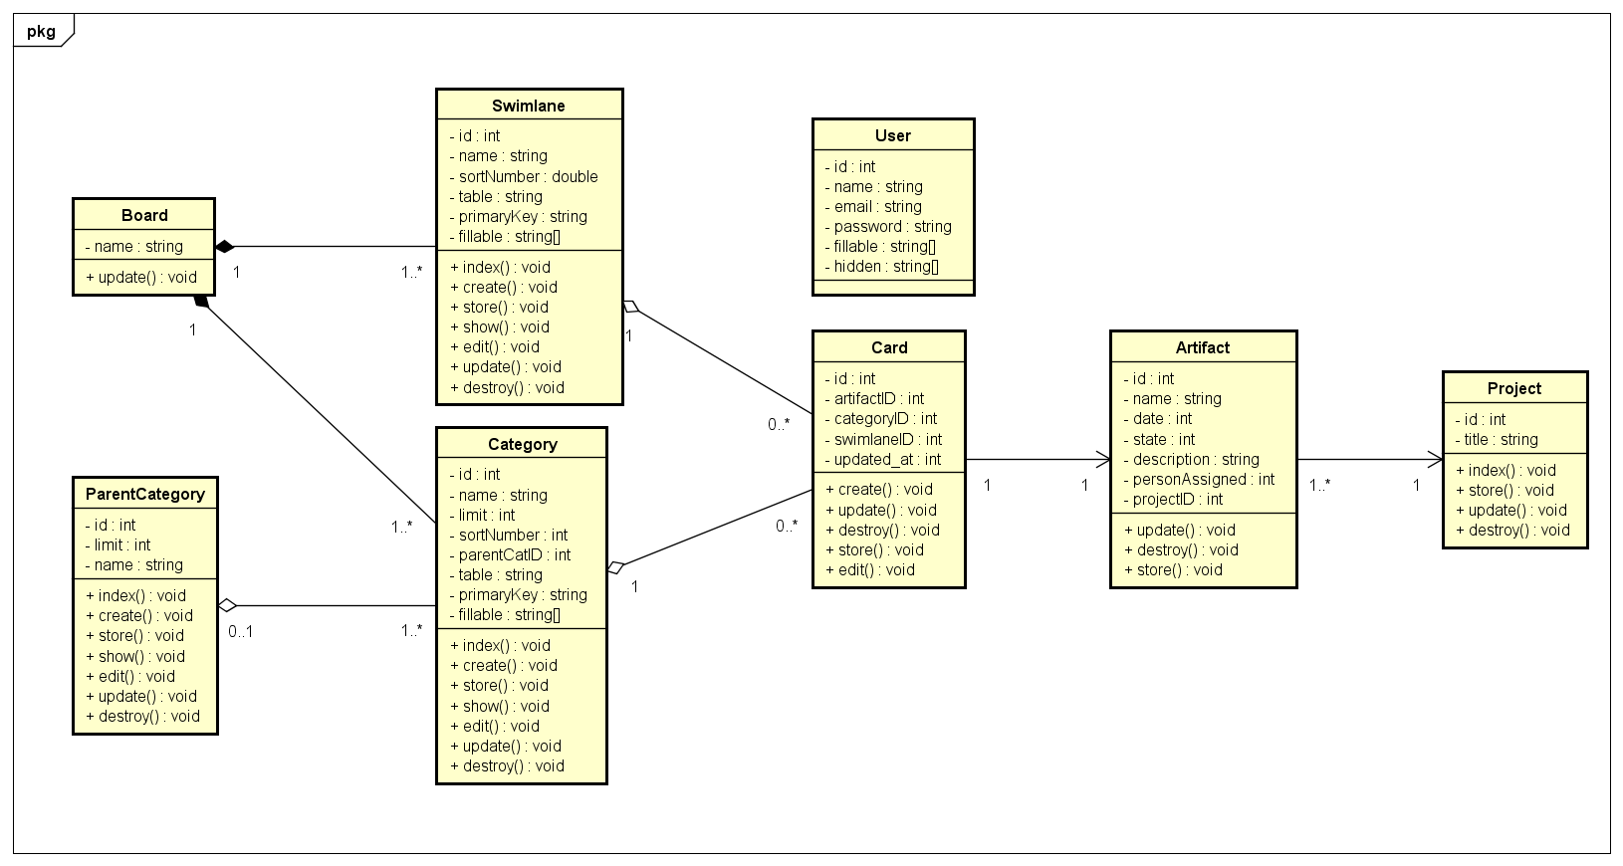

Slide 23
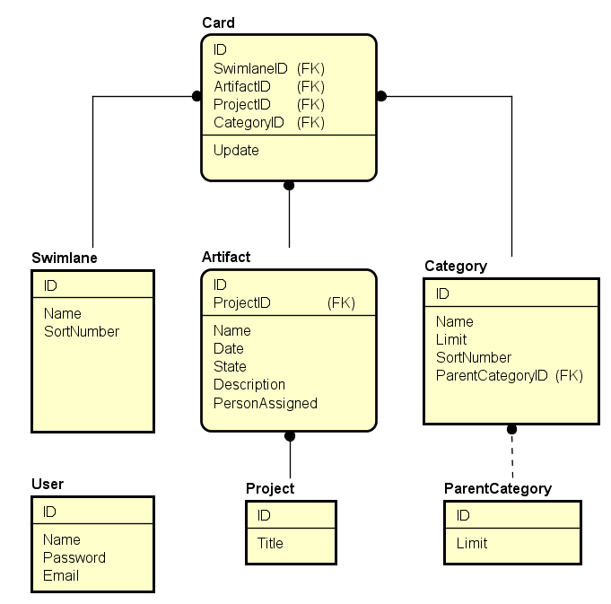

Slide 24
GUI
Simple design - Material Kit by Creative Tim
Small number of web site pages
One major functionality

Slide 25
Questions?

